Slide 1
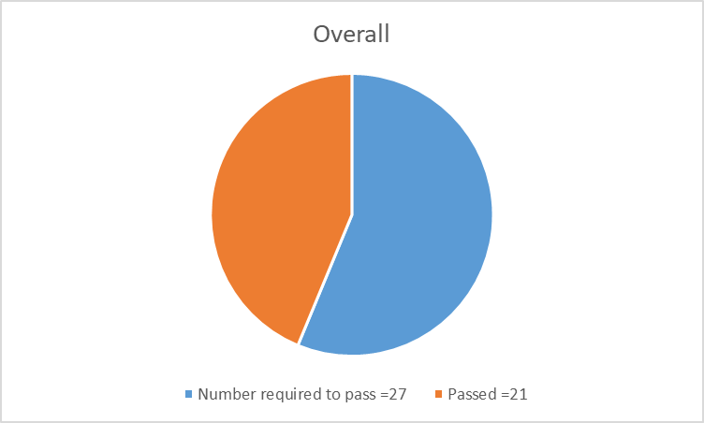
ASSESSMENT RESULTS
CPCE Exit Exam (minimum score of 50% required)

Slide 2
CPCE Results

Slide 3
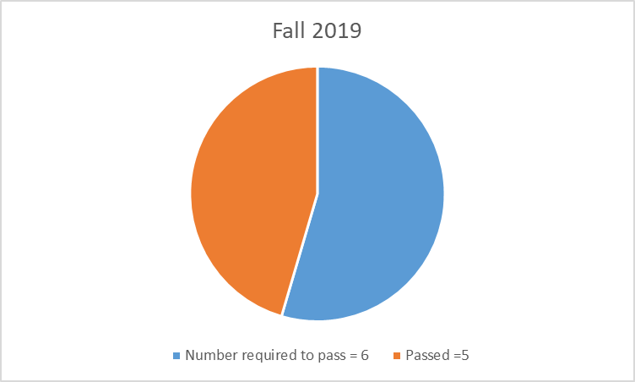
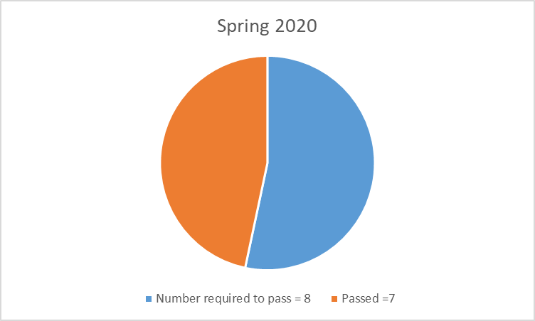
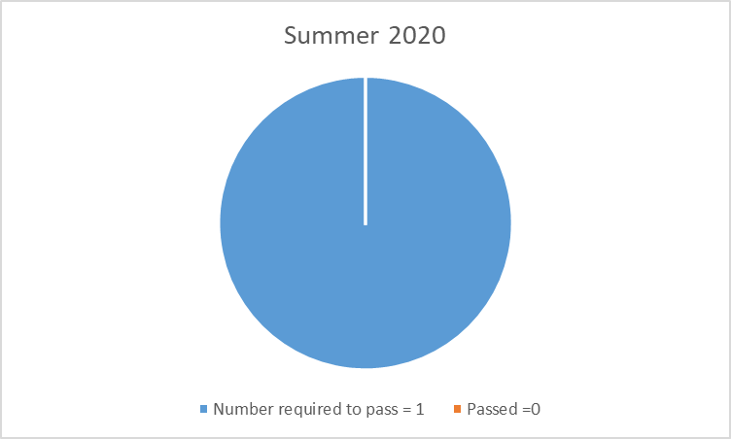
CPCE Results

